Slide 1
Decision Tree Regression(CART)
Presented by,
Akshaya K P

Slide 2
content
What is decision tree
What is CART
What is decision tree regression
Components of DTR(CART)
Mathematical understanding of decision tree regression with example
Parameter and Hyperparameter
Advantage and disadvantage
Applications

Slide 3
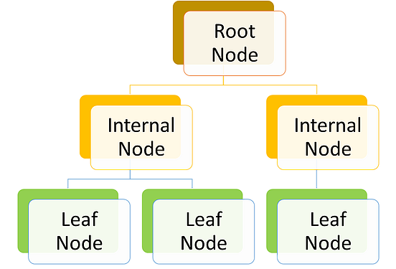
What is decision tree?
Decision tree is a supervised learning algorithm that works for both categorical and continuous input and output variables that is we can predict both categorical variables (classification tree) and a continuous variable (regression tree).

Slide 4
CART
CART (Classification and Regression Tree) is a popular decision tree algorithm that can be used for both classification and regression tasks. The algorithm builds a binary tree-like structure, where internal nodes represent decisions based on feature values, and leaf nodes represent the prediction.
Regression tree
A decision tree where the target variable is continuous/discrete
It uses least square / standard deviation reduction as a metric to select features in case of the Regression tree.
Example like predicting the price of a house, predicting the sell of crops

Slide 5
Decision Tree Regression in CART Decision Tree - Regression
Decision Tree Regression in CART (Classification and Regression Trees) is a machine learning technique for regression problems where the aim is to predict a continuous target variable based on the values of several input features. It works by recursively splitting the dataset into smaller subsets based on the feature that provides the best reduction in variance
The splits are made until a stopping criteria is reached, such as a minimum number of samples in a leaf node or a maximum depth of the tree. The prediction for a new instance is made by traversing the tree and taking the average value of the training instances in the corresponding leaf node.

Slide 6
The components of Decision Tree Regression in CART are:
Root node: The root node represents the entire dataset and the first split of the tree is made here.
Splitting criterion: The criterion used to determine the best feature to split the data on at each node. In regression, this is typically the reduction in variance.
Split: The process of dividing the data into subsets based on a feature value.
Internal nodes: Nodes other than the root and leaf nodes which represent the splits made on the features.
Leaf nodes: The final nodes in the tree that represent the prediction for a new instance. The prediction is made by taking the average of the target values of the instances in that node.
Pruning: The process of removing branches from the tree that do not contribute much to the prediction. This is done to avoid overfitting and to make the tree more interpretable.
Stopping criteria: The criteria used to determine when the tree building process should stop, such as a maximum depth or a minimum number of samples in a leaf node.

Slide 7
Mathematical understanding of decision tree regression with example
Experience | Education Gap | Salary
2 | Yes | 40k
2.5 | Yes | 42k
3 | No | 52k
4 | No | 60k
5 | yes | 56k

Slide 8
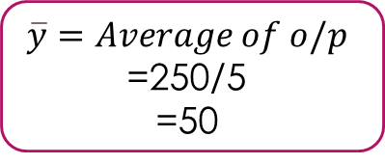
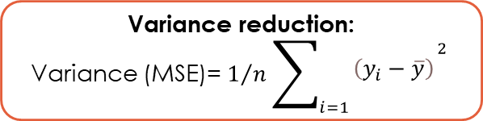
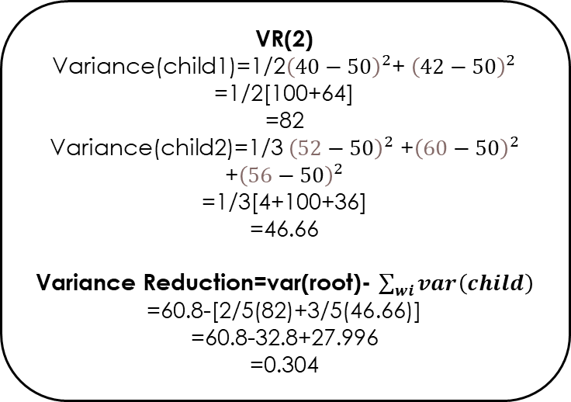
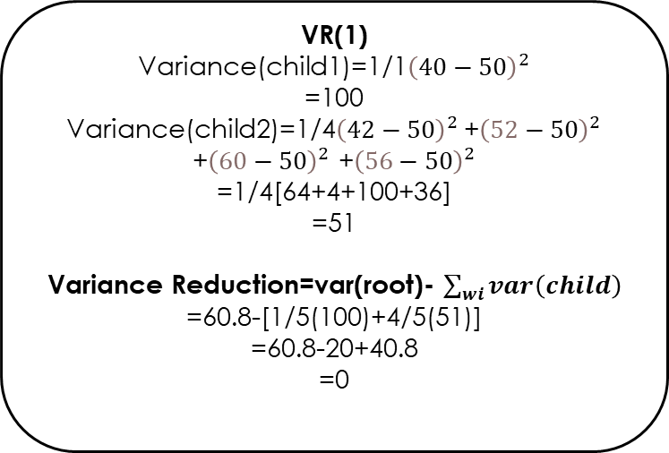
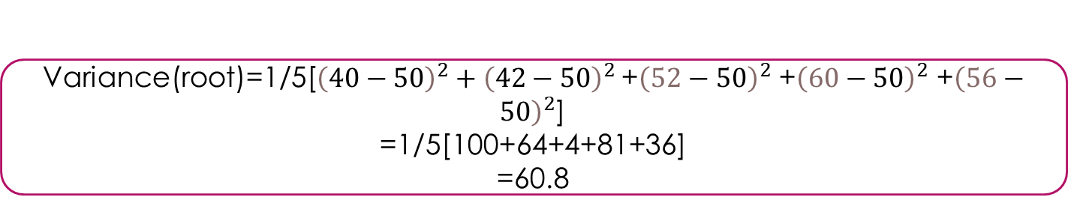
Variance(root)=1/5[${\left(40−50\right)}^{2}+{\left(42−50\right)}^{2}$ +${\left(52−50\right)}^{2}$ +${\left(60−50\right)}^{2}$ +${\left(56−50\right)}^{2}$]
=1/5[100+64+4+81+36]
=60.8
Variance reduction:
Variance (MSE)= $1/n\sum_{i=1}{\begin{aligned}{\left(y_{i}−\overline{y}\right)}^{\begin{aligned}2 \\ \end{aligned}} \\ \end{aligned}}$
<=2
<=2.5
$$\overline{y}=Average of o/p$$
=250/5
=50
40k
42,52,60,
56k
40,42k
52,60,56k
VR(1)
Variance(child1)=1/1${\left(40−50\right)}^{2}$
=100
Variance(child2)=1/4${\left(42−50\right)}^{2}$ +${\left(52−50\right)}^{2}$ +${\left(60−50\right)}^{2}$ +${\left(56−50\right)}^{2}$
=1/4[64+4+100+36]
=51
Variance Reduction=var(root)- $\sum_{wi}{var\left(child\right)}$
=60.8-[1/5(100)+4/5(51)]
=60.8-20+40.8
=0
VR(2)
Variance(child1)=1/2${\left(40−50\right)}^{2}$+ ${\left(42−50\right)}^{2}$
=1/2[100+64]
=82
Variance(child2)=1/3 ${\left(52−50\right)}^{2}$ +${\left(60−50\right)}^{2}$ +${\left(56−50\right)}^{2}$
=1/3[4+100+36]
=46.66
Variance Reduction=var(root)- $\sum_{wi}{var\left(child\right)}$
=60.8-[2/5(82)+3/5(46.66)]
=60.8-32.8+27.996
=0.304
VR(2)>VR(1)

Slide 9
Parameter AND Hyperparameter
In Decision Tree Regression in CART, parameters are the values that the model learns from the training data during the training process, while hyperparameters are the values that are set before training, to control the learning process itself.
The hyperparameters in Decision Tree Regression in CART include:
Maximum depth: The maximum depth of the tree, which determines the maximum number of splits that can be made in the tree.
Minimum samples per leaf: The minimum number of samples required to be in a leaf node.
Splitting criterion: The criterion used to evaluate the quality of a split and choose the best feature to split on.
Pruning: The process of removing branches from the tree that do not contribute significantly to the prediction accuracy.
Maximum features: The maximum number of features considered for splitting at each no

Slide 10
Advantages of Decision Tree Regression in CART:
Interpretability: Decision trees are easy to interpret and visualize, allowing the user to understand the relationship between the features and the target variable, and how the model is making predictions.
Handling missing values and non-linear relationships: Decision trees can handle missing values and non-linear relationships between the features and target variable without requiring additional pre-processing.
Fast Training and Prediction: Decision trees can be trained and make predictions very quickly, making them a good choice for large datasets.
Robust to Outliers: Decision trees are robust to outliers, and do not require normalization of the input data.

Slide 11
Disadvantages of Decision Tree Regression in CART:
Overfitting: Decision trees can easily overfit the training data, leading to poor generalization to new, unseen data.
Instability: Small changes in the training data can result in large changes in the structure of the tree, leading to instability in the model.
Bias towards features with many categories: Decision trees can be biased towards features with many categories, as they tend to appear higher up in the tree.

Slide 12
Applications
Business and Economics: Decision trees can be used to predict consumer behavior, forecast market trends, and make investment decisions.
Healthcare: Decision trees can be used to diagnose diseases, predict patient outcomes, and personalize treatments based on individual patient characteristics.
Environmental Science: Decision trees can be used to predict the impact of environmental changes on biodiversity, ecosystems, and species populations.
Marketing: Decision trees can be used to analyze customer demographics, preferences, and behavior, and to develop targeted marketing campaigns.
Fraud Detection: Decision trees can be used to identify unusual patterns of behavior and detect potential fraudulent activity in financial transactions.
Quality Control: Decision trees can be used to identify the causes of defects in products, and to improve quality control processes in manufacturing.
Agriculture: Decision trees can be used to predict crop yields, and to optimize irrigation, fertilization, and pest control practices.

Slide 13
References
https://www.saedsayad.com/decision_tree_reg.htm
https://ankitnitjsr13.medium.com/math-behind-decision-tree-algorithm-2aa398561d6d
https://www.datascienceprophet.com/understanding-the-mathematics-behind-the-decision-tree-algorithm-part-i/
https://www.geeksforgeeks.org/cart-classification-and-regression-tree-in-machine-learning/
https://towardsdatascience.com/decision-trees-d07e0f420175

Slide 14
THANK YOU

